Slide 1


A New Bayesian Method for Comparing Demographic Models
By Ron Visbord,
under supervision of Dr. Ilan Gronau

Slide 2
Agenda
Sneak Peak
Preliminaries
Model Selection (and Model Fit)
Review Parameter Inference + G-PhoCS
Methods
The Harmonic Mean estimator 😔
Relative Bayes Factors 😊
Reference Models
Calculating RBFs Efficiently
Results!

Slide 3

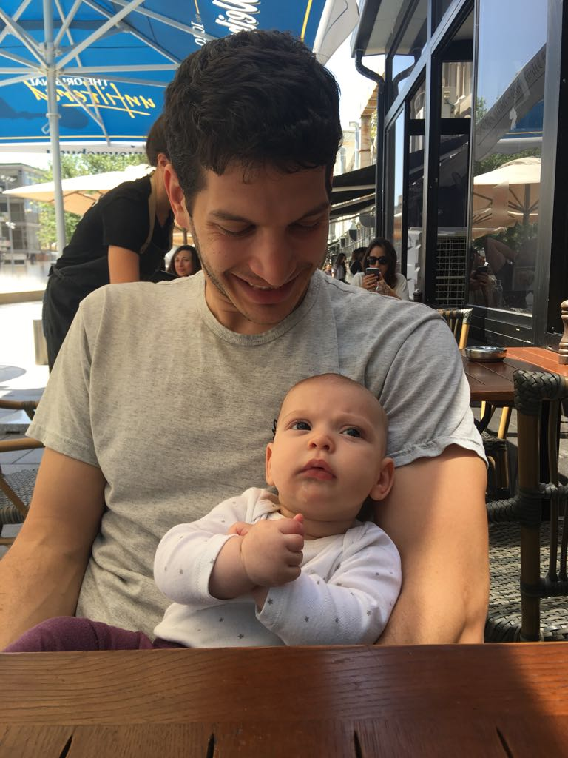
The Team

Slide 4
Preliminaries

Slide 5
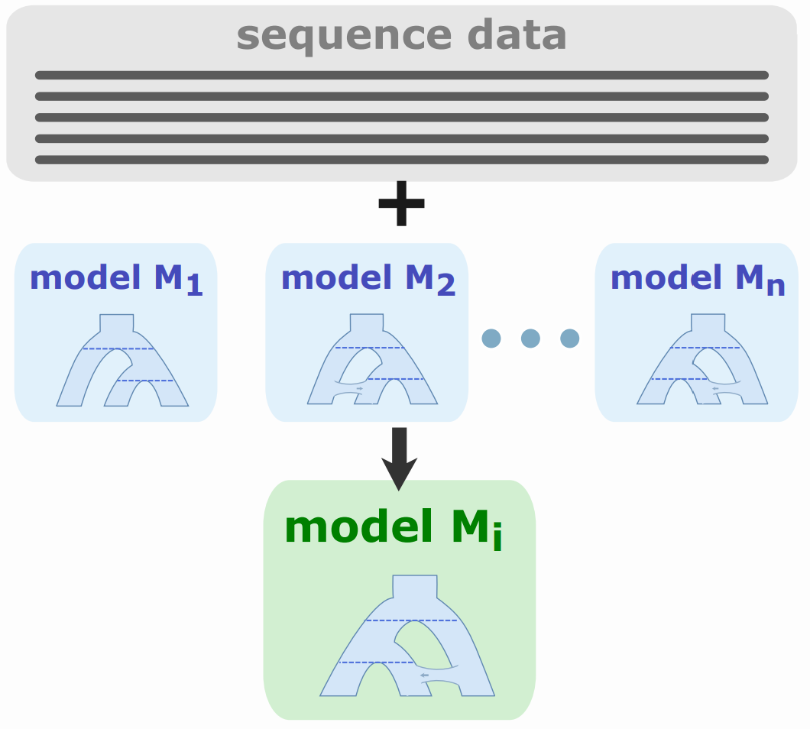
What is Model Selection?
Notes:
Todo – take the drawing from svg instead of prtscr

Slide 6
Objectives
use likelihood P(X|M) to measure model fit
assess structural properties and not specific parameter values
use mechanism from existing demography inference methods to approximate P(X|M) via importance sampling

Slide 7
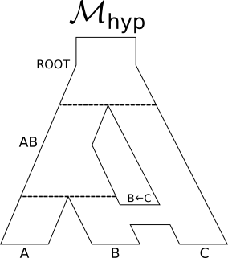
What is a Population Model?
M = (T, B, Θ)
Τ = { ROOT, AB, A, B, C }

Slide 8
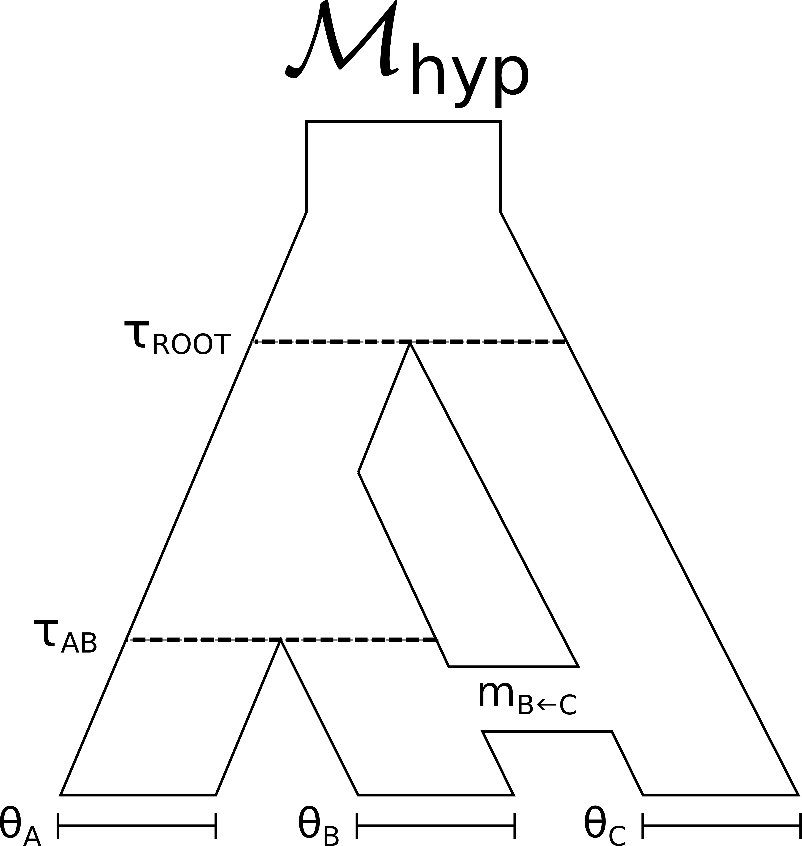
What is a Population Model?
M = (T, B, Θ)

Slide 9
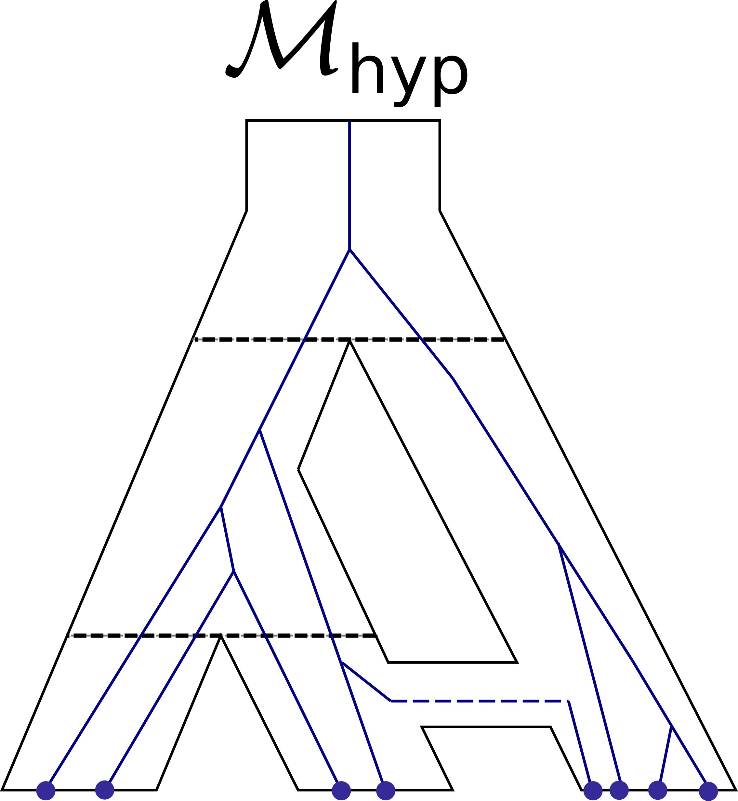
What is a Population Model?
G, X

Slide 10
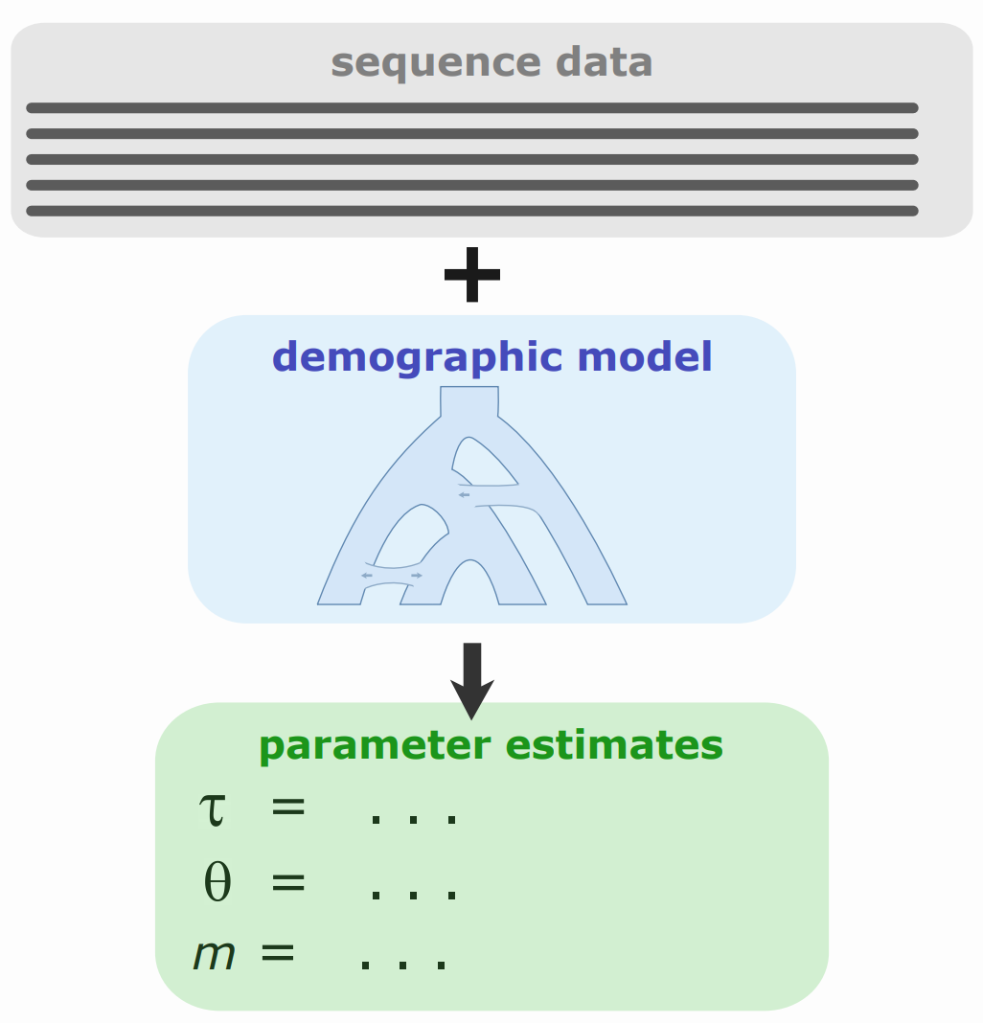
What is Population Parameter Inference?
Notes:
Todo – take the drawing from svg instead of prtscr

Slide 11
What's G-PhoCS?
A "Generalized Phylogenetic Coalescent Sampler"
P(X,G,Θ|M) = P(Θ|M) P(G|M,Θ) P(X|G) = P(Θ|M) π_l P(G_l|M,Θ) P(X_l|G_l).

Slide 12
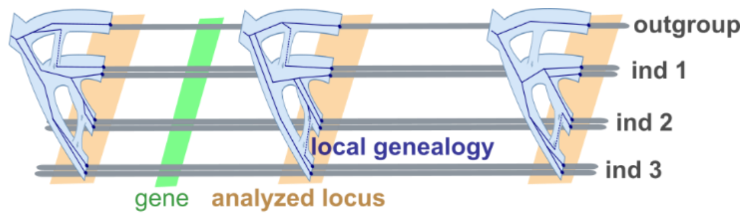
What is G-PhoCS?
Metropolis-Hastings updates:
Update coalescent times
Update genealogy structure
Update θp
Update τp
Rescale all parameters
Notes:
Metropolis-Hastings updates:
Update coalescent times For each individual coalescent event in each population, perturb the time of the event without changing the topology of the genealogy or any other coalescent time.
Update genealogy structure: For each subtree of each genealogy, alter the subtree using a subtree prune-and-regraft operation.
Update θp: For each population p, slightly perturb θp.
Update τp: For each population p, slightly perturb τp. If nescessary, also “stretch” or "squeeze" each genealogy Gi as needed to accommodate the proposed change in τp.
Rescale all parameters: Slightly perturb all model parameters θp, τp, mb and all coalescent times across all genealogies by a multiplicative factor sampled close to 1.

Slide 13
Methods

Slide 14
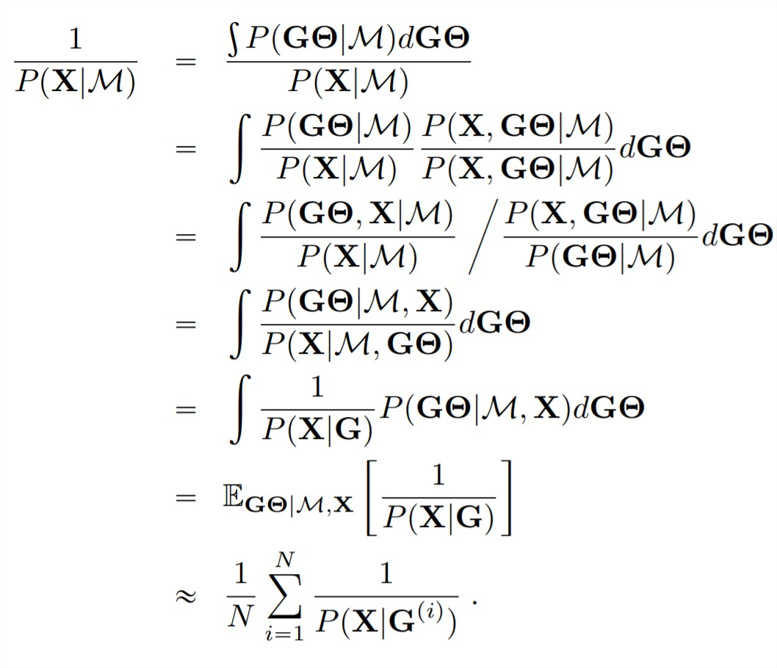
Harmonic Mean Estimator

Slide 15
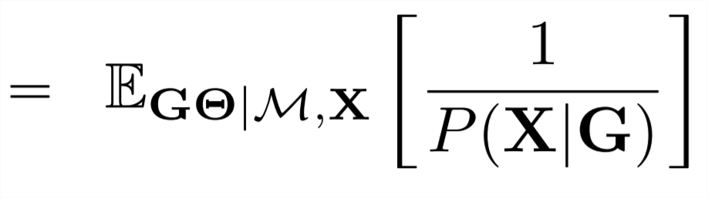
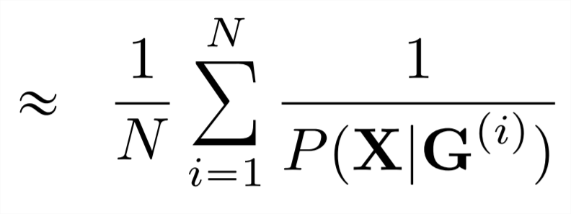
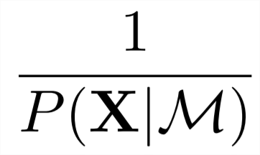
Harmonic Mean Estimator
Widely applicable and simple
1/P(X|G) has very high variance
Poor results In practice

Slide 16
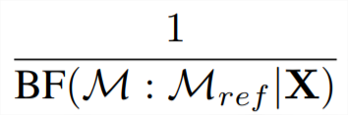
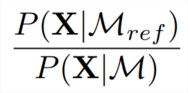

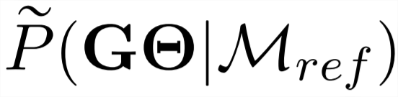
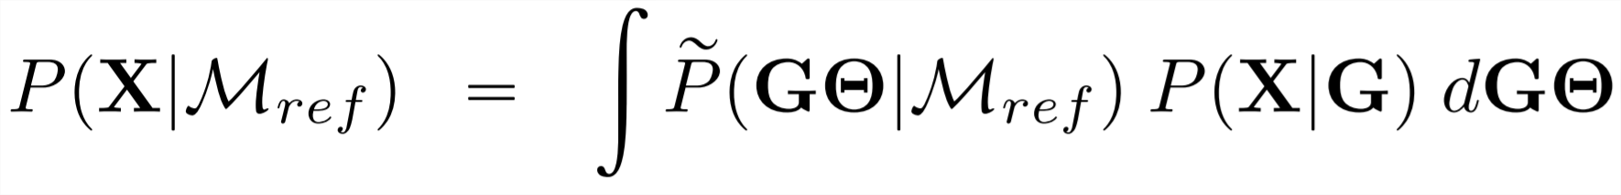
Relative Bayes Factors
Define a model pairing conditional distribution, , s.t. :

Slide 17
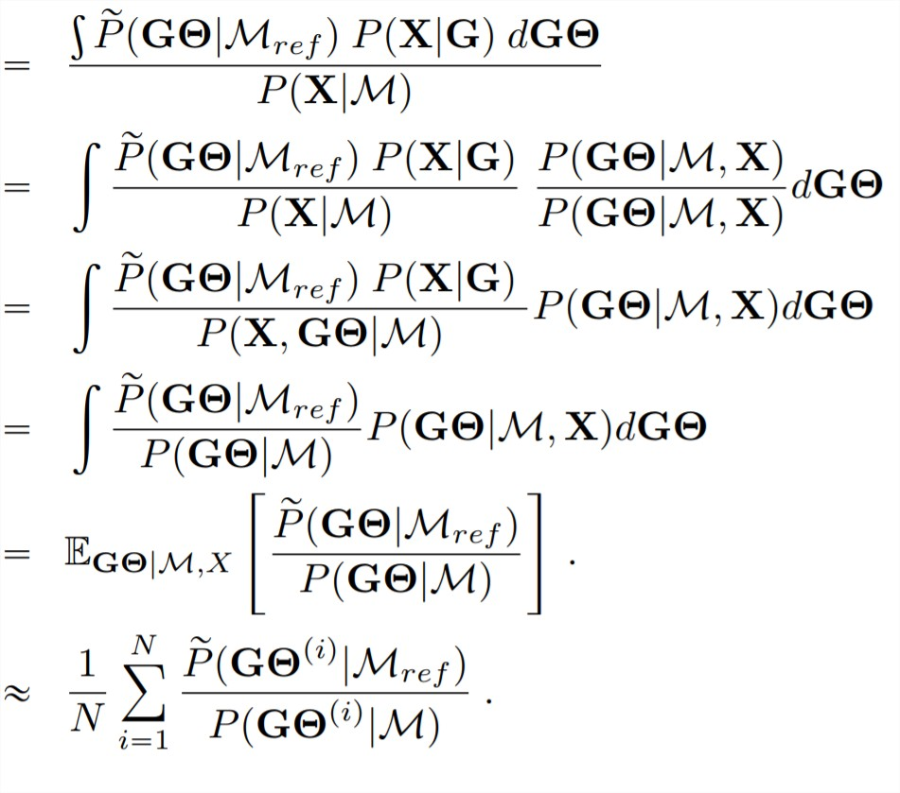
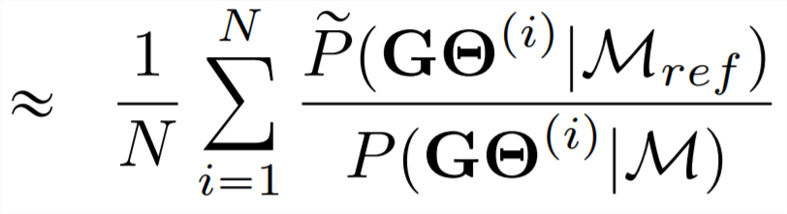
Relative Bayes Factors

Slide 18
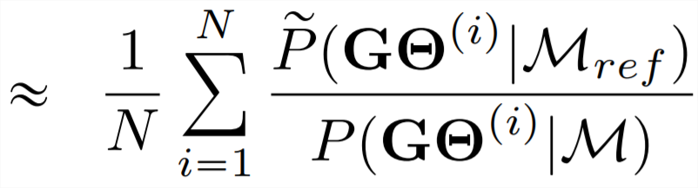
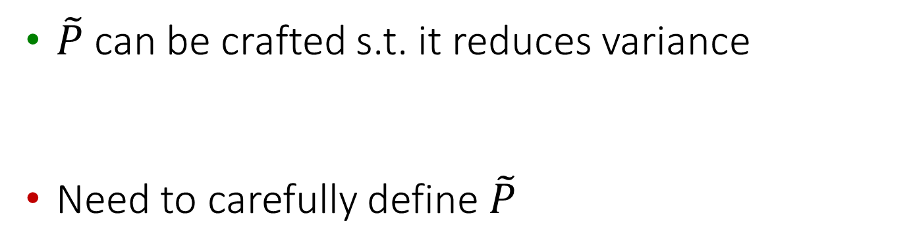
Relative Bayes Factors
$\tilde{P}$ can be crafted s.t. it reduces variance
Need to carefully define $\tilde{P}$
So lets do it!
Notes:
TODO – ask Ilan for suggestion for upside of P¬
Trivia example – if P¬ == P then RBF == 1 and variance is 0
So now we need to define P¬!

Slide 19
RBFs in action
To explain RBFs intuition:
…Maybe slide with “sneak peak” showing how two hypothesis models are compared via a reference model, to

Slide 20
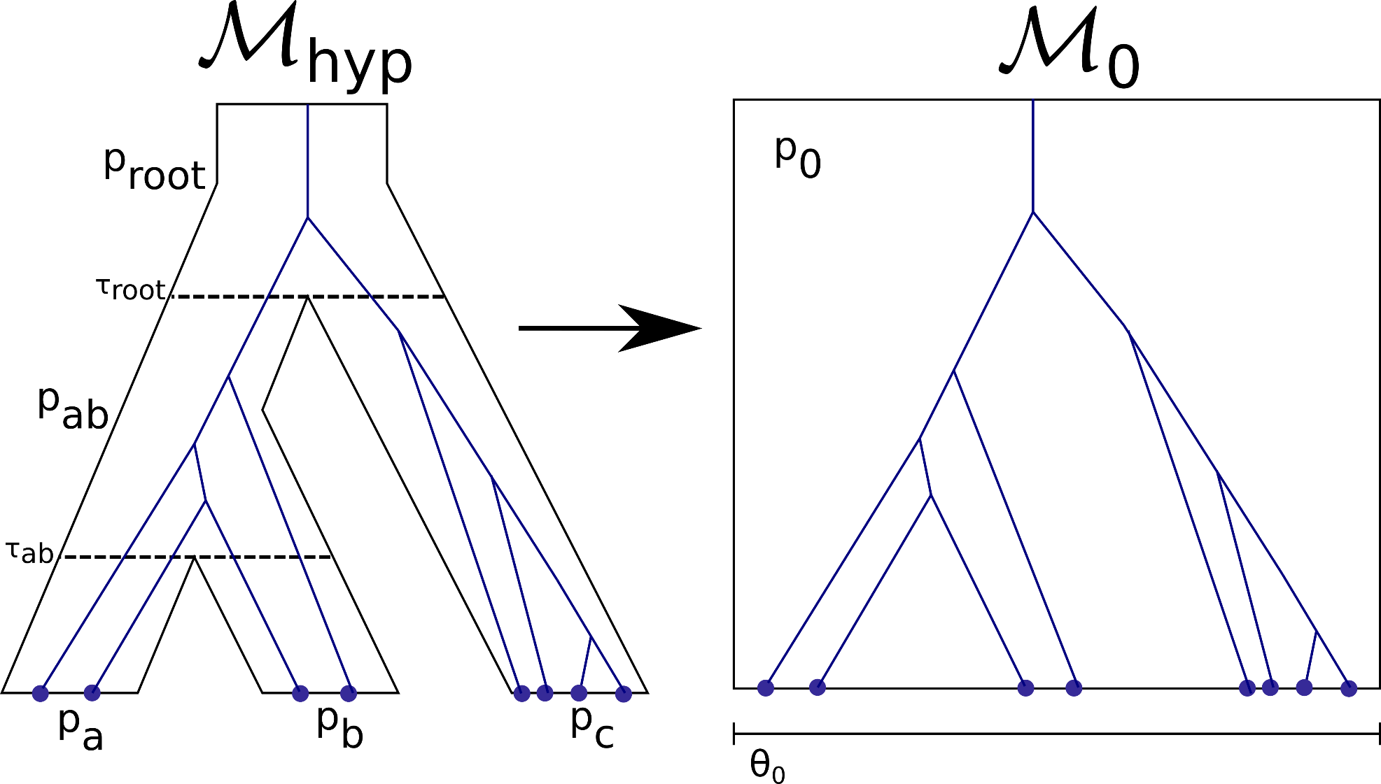
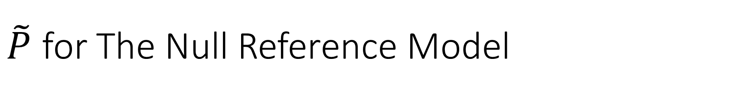
$\tilde{P}$ for The Null Reference Model

Slide 21
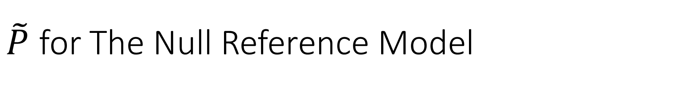
$\tilde{P}$ for The Null Reference Model
…develop P~ for null reference model
…Describe mapping of params

Slide 22
Tau Priors in the Null Reference Model
…briefly develop tau bounds

Slide 23
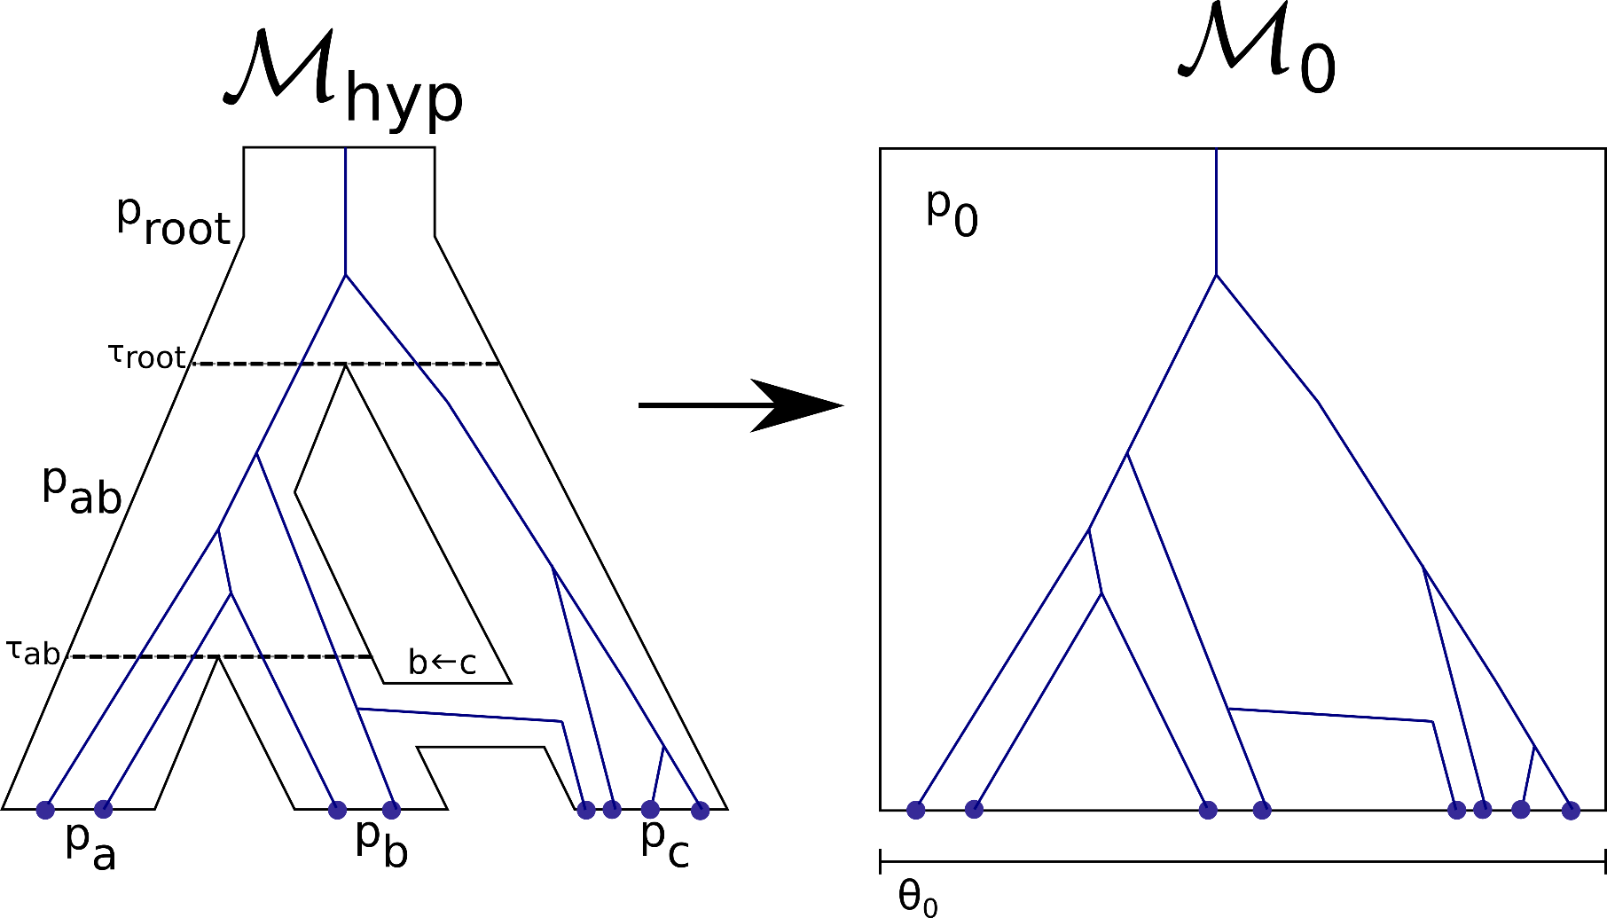
Null Reference Model With Migration

Slide 24
Tau Priors With Migration
…briefly develop mig tau bounds

Slide 25
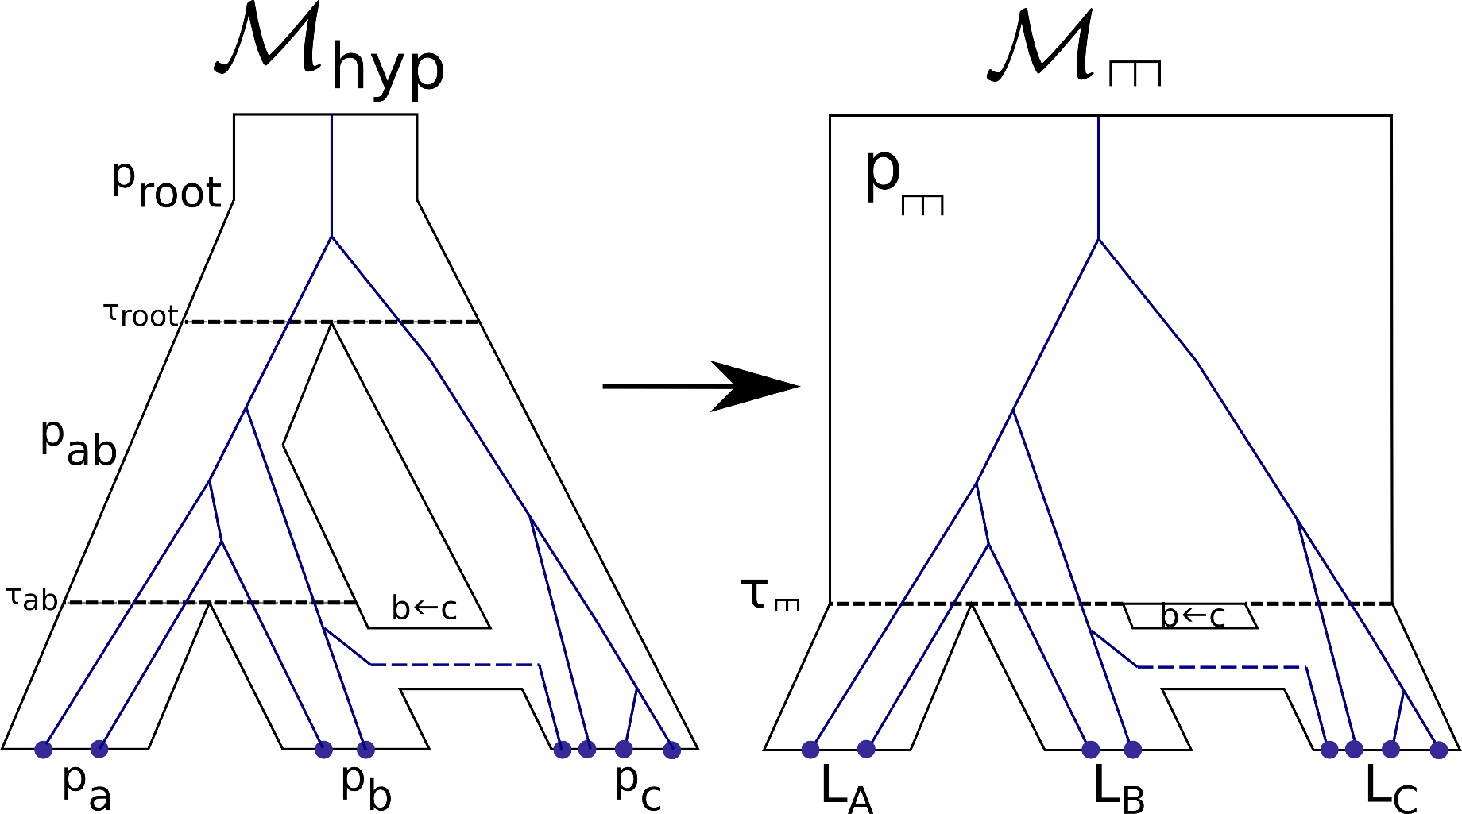
Comb Reference Model

Slide 26
SubTree Reference Model
…show that a ref-model on a sub tree causes everything outside the subtree to cancel out [Maybe this was already shown in development of ~Ps]

Slide 27
Constructing a Reference Model
Choose a subtree of the of M
Collapse the subtree into a Clade/Comb
Map the remaining hidden parameters

Slide 28
Calc Scheme

Slide 29
Calculation Scheme Objective
Objective for our “sufficient stats”
~|M|
For All Reference model
Single MCMC

Slide 30
Genealogy Likelihood Recap
Kingman Coalescent + migration -> … -> sufficient stats (for a single ref model)

Slide 31
Recursive Sufficient Stats

Slide 32
Tying it all together

Slide 33
McRef
>>> git clone http://github.com/selotape/mcref
>>> cd mcref
>>> python3 install –r requirements.txt
>>> python3 mcref ./simulations/sample
Show config file
Show debug plots
Show example results table

Slide 34
Results

Slide 35
Results
Experiment I & III - Assess model comparison
Explain how we test hypotheses by example
Varying divergence time
Varying migration rate
Experiment II - Compare reference models

Slide 36
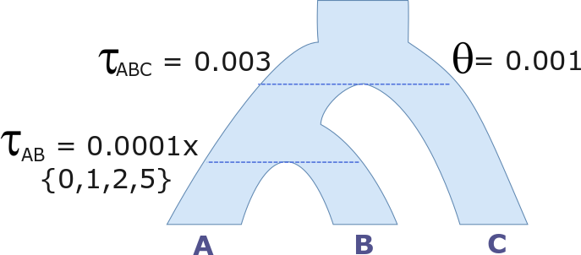

Exp I – Varying Divergence Time
Notes:
TODO – color changing taus

Slide 37
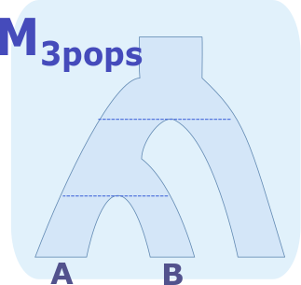
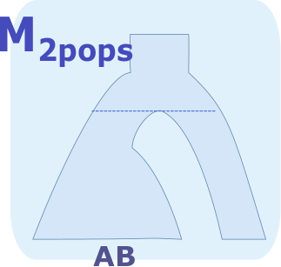
Exp I – Varying Divergence Time
vs.
Notes:
TODO – remove numbers from top drawing

Slide 38
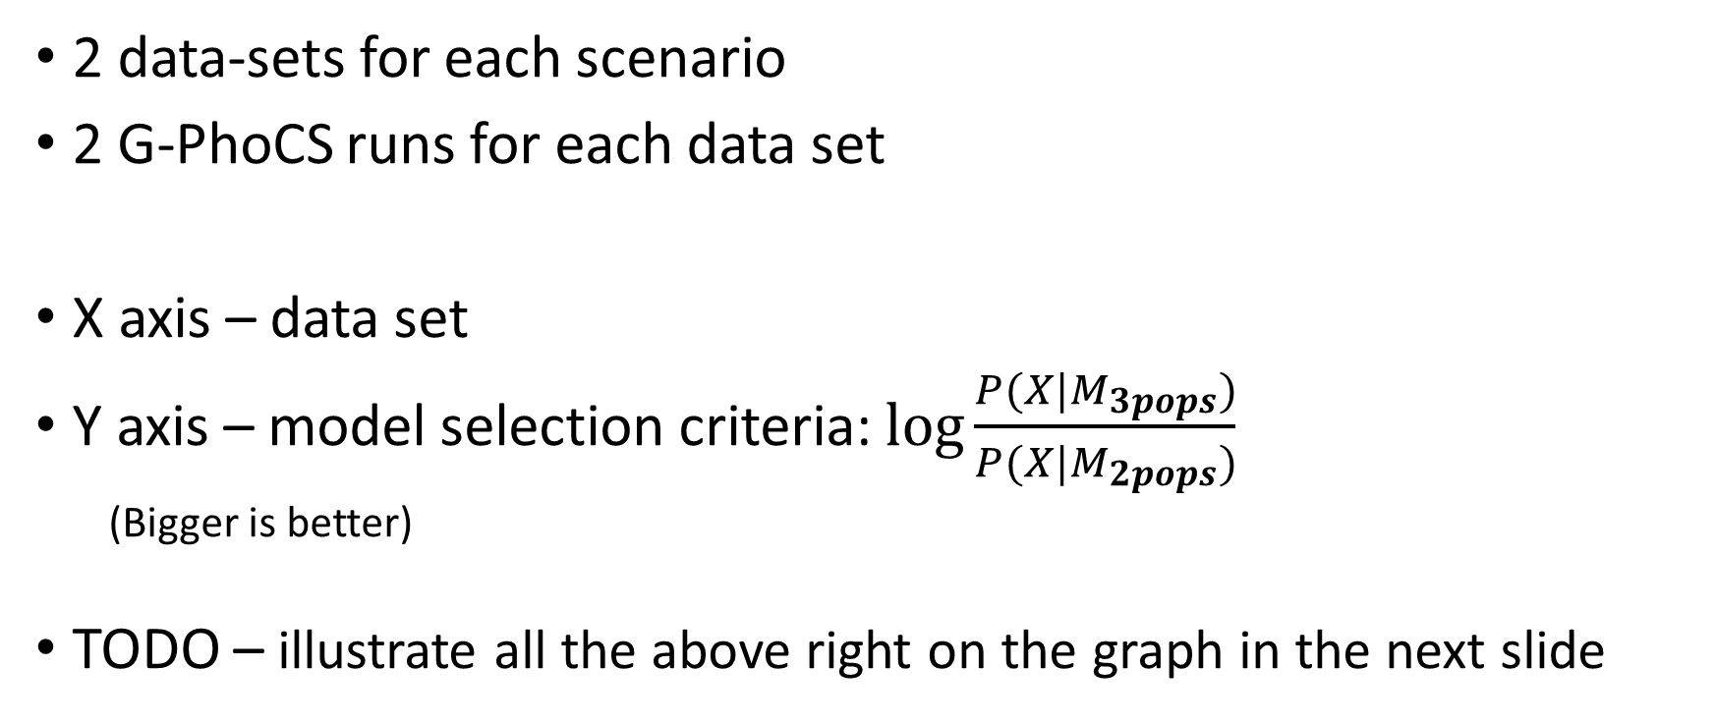
Exp I – Varying Divergence Time
2 data-sets for each scenario
2 G-PhoCS runs for each data set
X axis – data set
Y axis – model selection criteria: $\log{\frac{P(X|M_{3pops})}{P(X|M_{2pops})}}$
(Bigger is better)
TODO – illustrate all the above right on the graph in the next slide

Slide 39
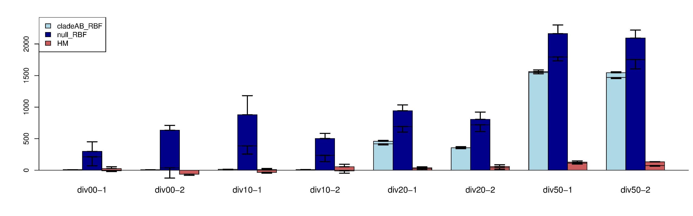
Exp I – Varying Divergence Time

Slide 40

Exp I – Varying Divergence Time
HM and both RBFs eventually select the correct model
RBFs succeed @ ~20 while HM only @ ~50
Null ref model is much noisier than Clade(AB)

Slide 41
Exp I – Varying Divergence Time
HM and both RBFs eventually select the correct model
RBFs succeed @ ~20 while HM only @ ~50
Null ref model is much noisier than Clade(AB)
Bottom line –
RBF out performs HM in detecting population split

Slide 42
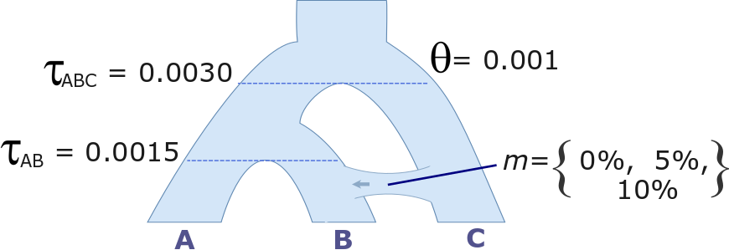
Exp II – Varying Migration Rate

Slide 43
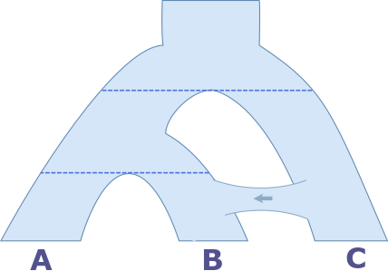
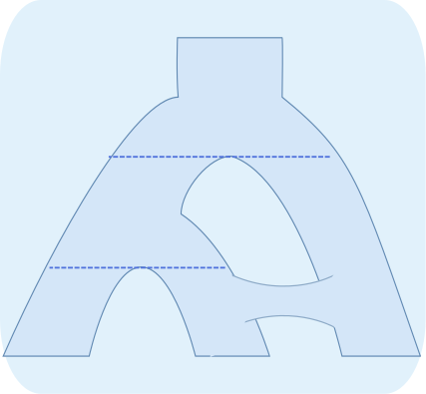
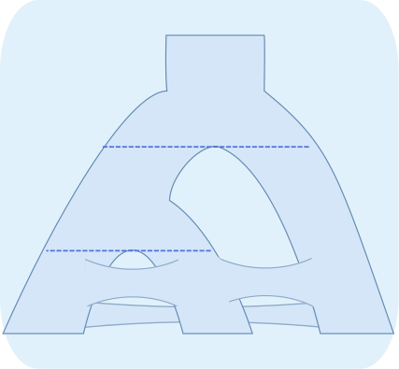
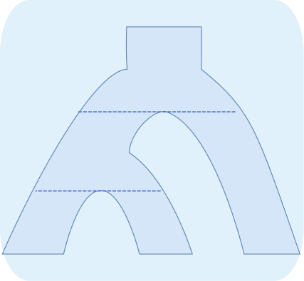
Exp II – Varying Migration Rate
M_{migBC}
M_{migAll}
M_{noMig}
M_{migCB}
vs.
B C
B C
A B C
X

Slide 44
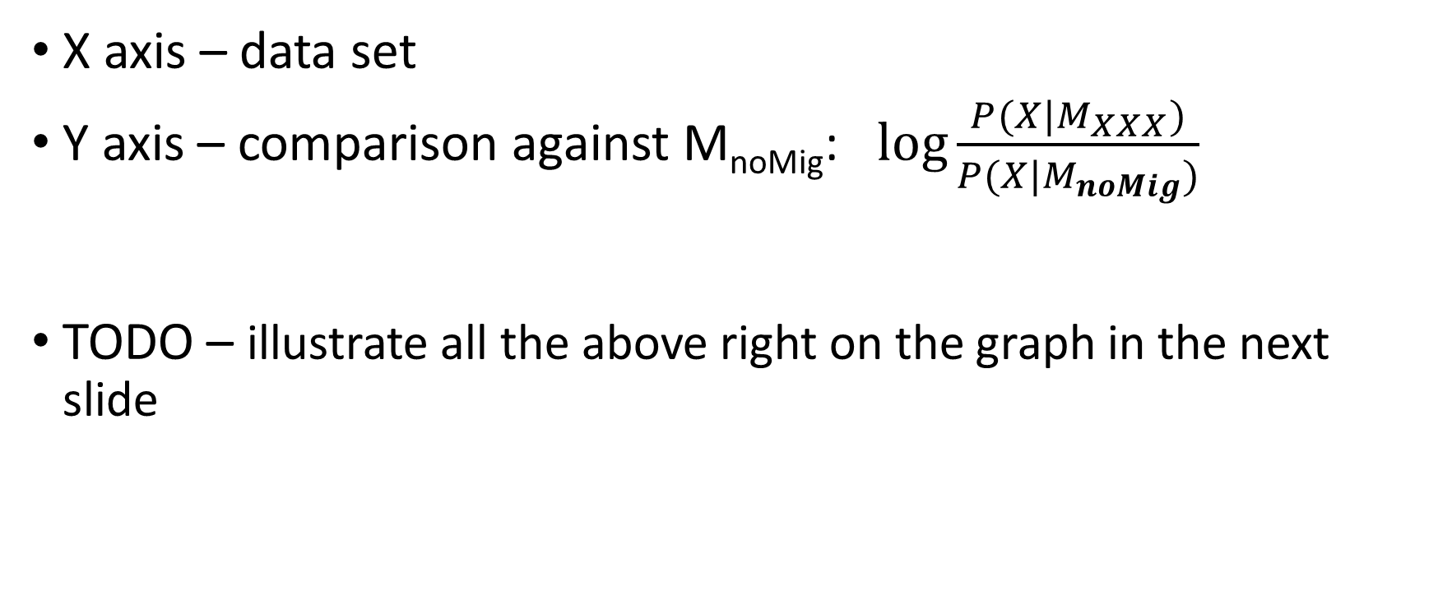
Exp II – Varying Migration Rate
X axis – data set
Y axis – comparison against M_{noMig}: $\log{\frac{P(X|M_{XXX})}{P(X|M_{noMig})}}$
TODO – illustrate all the above right on the graph in the next slide

Slide 45
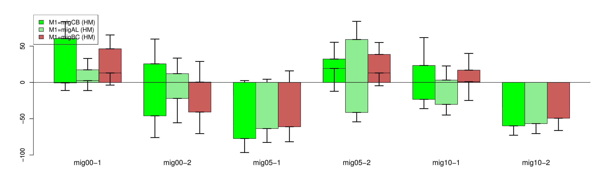
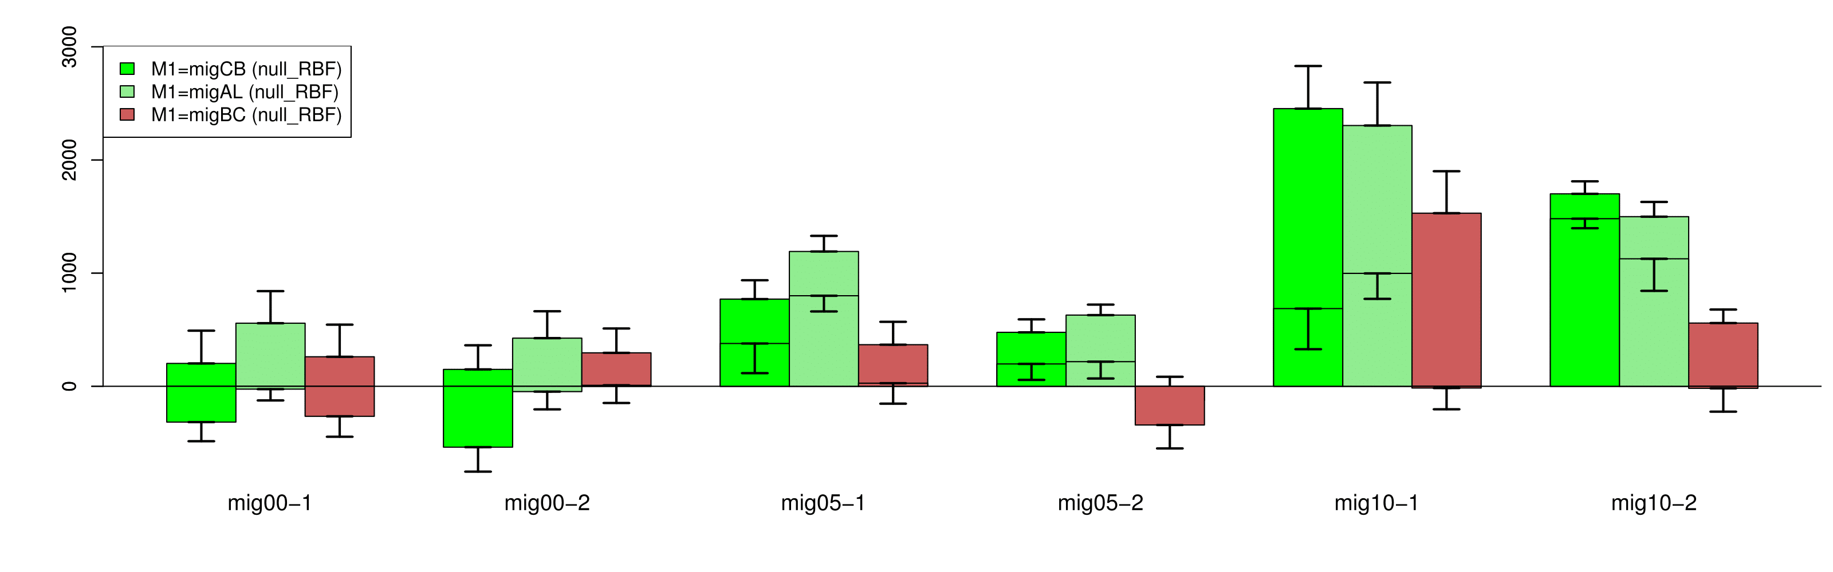
Exp II – Varying Migration Rate - HM
HM
Null RBF

Slide 46
Exp II – Varying Migration Rate
HM never significantly prefers any model over M_{nomig}
When m_{B⬅C} > 0, Null RBF Favours the two models with correct flow (M_{CB} & M_{migAll}) over
RBFs scores higher the model with correct migration direction
When m_{B⬅C} > 0 then M_{CB} , M_{migAll} >^{RBF} M_{noMig}, M_{BC}
RBF shows no clear preference between M_{CB} and M_{migAll}
Bottom line –
RBF out-performs HM in migration detection, however there is still room for improvement
HM
Null RBF

Slide 47
Exp II – Varying Migration Rate
HM never significantly prefers any model over M_{nomig}
When m_{B⬅C} > 0, Null RBF Favours the two models with correct flow (M_{CB} & M_{migAll}) over
RBFs scores higher the model with correct migration direction
When m_{B⬅C} > 0 then M_{CB} , M_{migAll} >^{RBF} M_{noMig}, M_{BC}
RBF shows no clear preference between M_{CB} and M_{migAll}
Bottom line –
RBFs out-performs HM in migration detection, however there is room for improvement

Slide 48
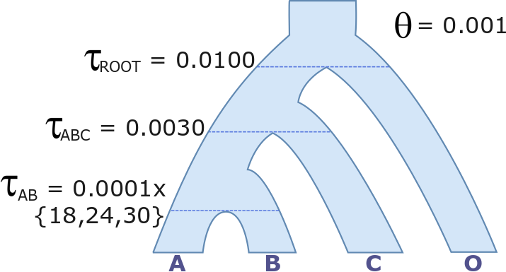
Exp III – Alternative Reference Models

Slide 49
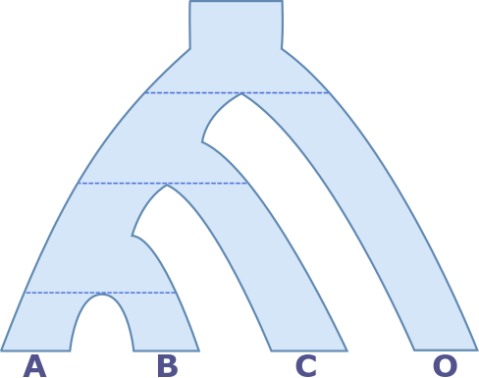
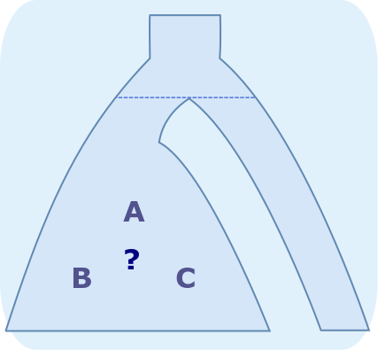
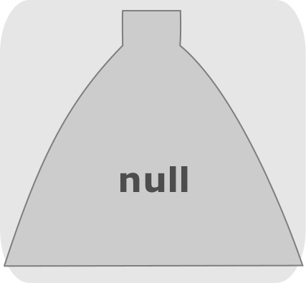
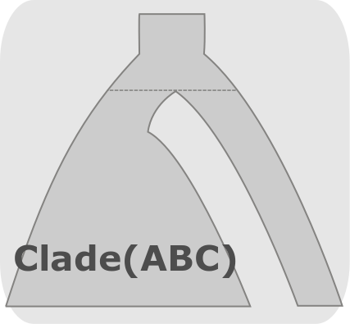
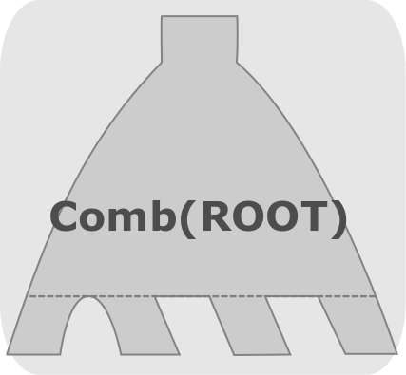
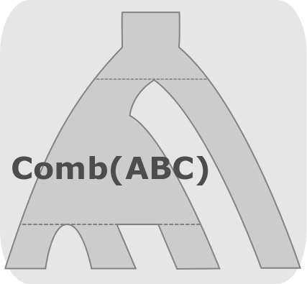
Exp III – Alternative Reference Models

Slide 50
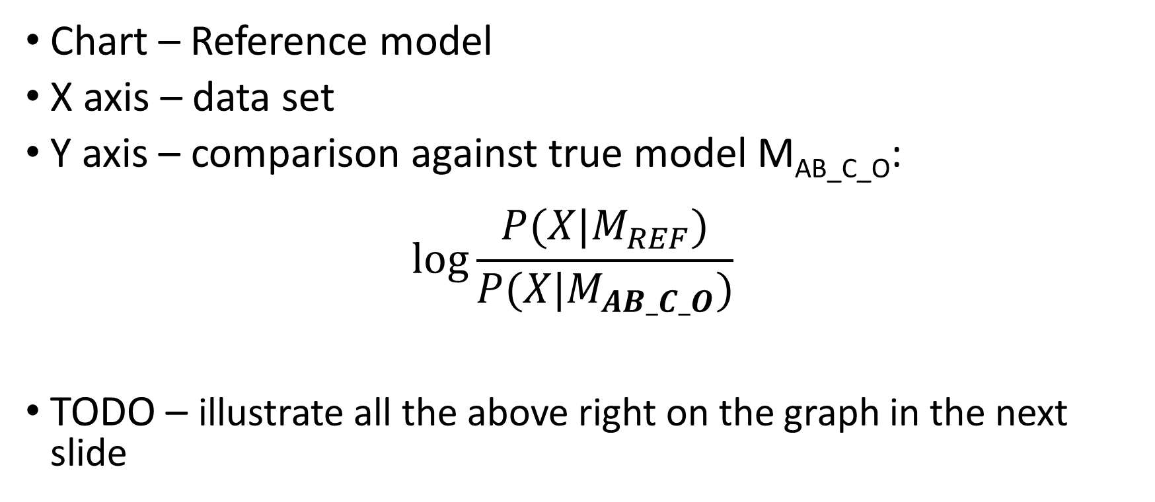
Exp III – Alternative Reference Models
Chart – Reference model
X axis – data set
Y axis – comparison against true model M_{AB_C_O}: $\log{\frac{P(X|M_{REF})}{P(X|M_{AB_C_O})}}$
TODO – illustrate all the above right on the graph in the next slide

Slide 51
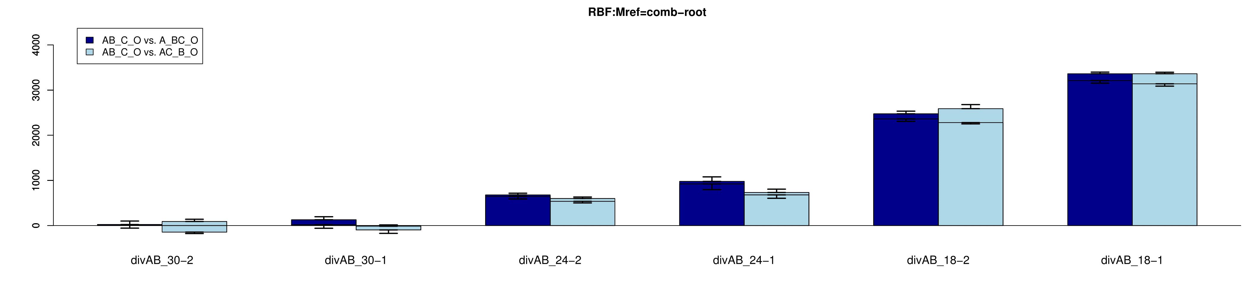
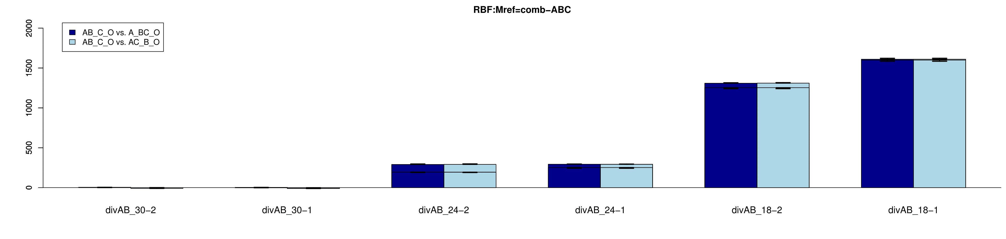
Comb(ROOT)
Comb(ABC)

Slide 52
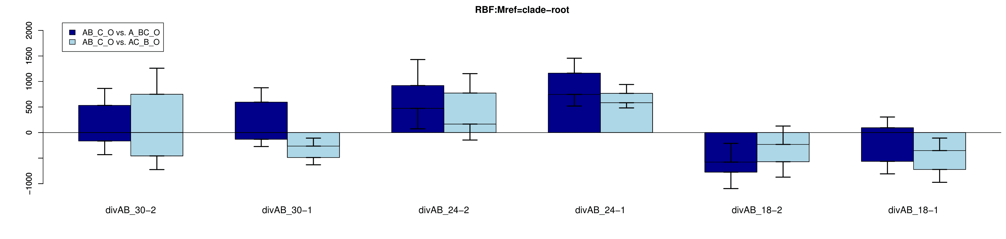
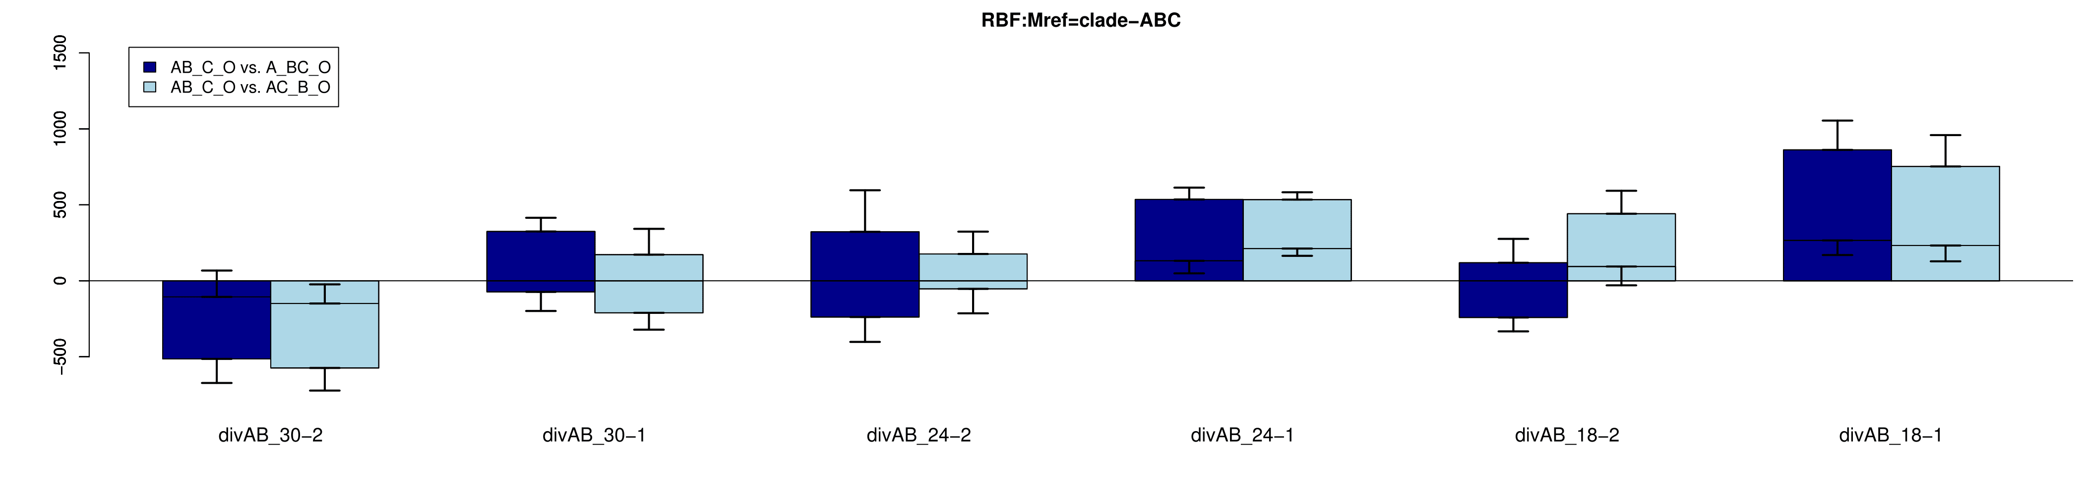
Clade(ROOT)
Clade(ABC)

Slide 53
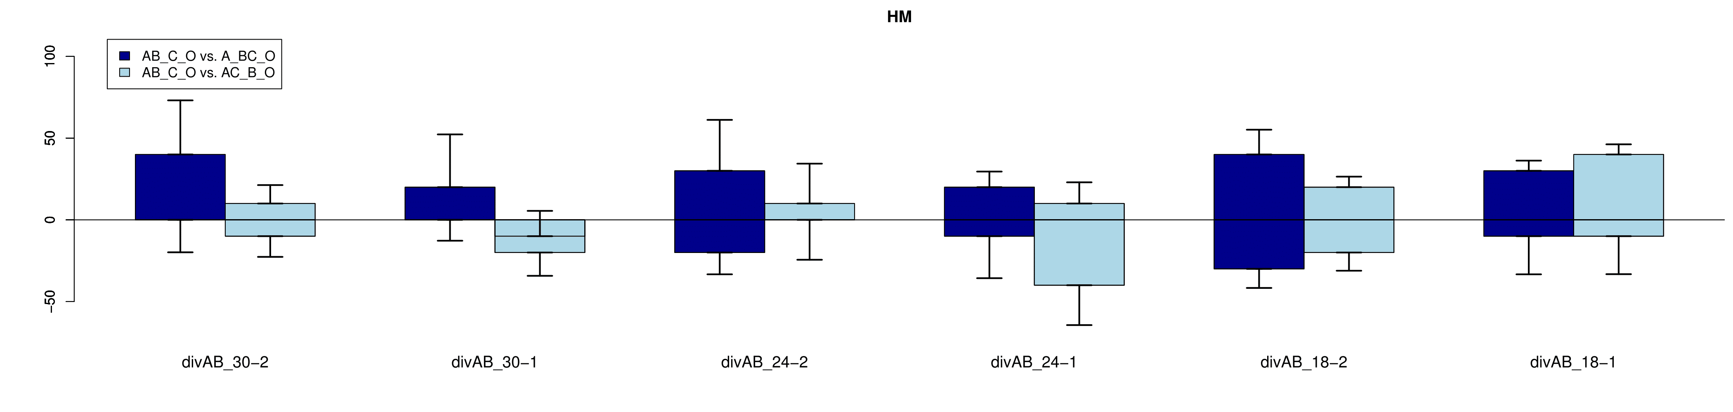
HM

Slide 54
Exp III – Alternative Reference Models
The two comb reference methods clearly and confidently choose the true hypothesis model, M_{AB_C}
They also correctly show no preference when M_{AB_C} = M_{A_BC} = M_{AC_B}
Comb(ABC) show more stable results
Comb(ABC)

Slide 55
Exp III – Alternative Reference Models
The two comb reference methods clearly and confidently choose the true hypothesis model, M_{AB_C}
They also correctly show no preference when M_{AB_C} = M_{A_BC} = M_{AC_B}
Comb(ABC) show more stable results
Comb(ROOT)

Slide 56
Exp III – Alternative Reference Models
Neither clade method nor HM show any semblence of selection. They do show a high degree of uncertainty
Arguably, Clade(ABC) shows an upward trend and will eventually succeed
Clade(ABC)

Slide 57
Exp III – Alternative Reference Models
Neither clade method nor HM show any semblence of selection. They do show a high degree of uncertainty
Arguably, Clade(ABC) shows an upward trend and will eventually succeed
Clade(ROOT)

Slide 58
Exp III – Alternative Reference Models
Neither clade method nor HM show any semblence of selection. They do show a high degree of uncertainty
Arguably, Clade(ABC) shows an upward trend and will eventually succeed
HM

Slide 59
Exp III – Alternative Reference Models
Bottom line –
Choice of reference model has a major impact on performance. The more localized the reference model is to the disputed hypothesis region, the better the algorithm performed.

Slide 60
Conclusions

Slide 61
Recap

Slide 62
Future Work

Slide 63
Fin

